Slide 1
Senior Managing Diabetes -Group 10

Slide 2
Phase 1
1

Slide 3
introduction to problem space
Diabetes:
has several different forms, but all related to the body not produce enough insulin, or not responding to it.
insulin metabolizes glucose (sugar), so is critical to ensuring energy is available
Complications:
failing to manage diabetes can result in loss of limbs, loss of sight, and even premature death
Seniors:
are most commonly diagnosed with type 2 diabetes
are less apt to use sophisticated technologies to assist daily tasks
may have the least support to manage health issues
Quantified self:
smartphones are becoming commonly used to manage fitness, diet, and health
the diabetes health condition must also be carefully managed
1

Slide 4
Phase 2
2

Slide 5
user research
prepared interview script
planned to be the primary instrument
prepared questionnaire and observation plan
recruited relatives, friends, and friends of friends
2

Slide 6
Phase 3
3

Slide 7
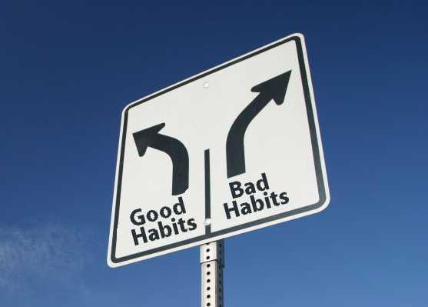
user research
user needs:
learn how to use the tools and devices
learn how to interpret the device information
learn what decisions to make and when
learn how to balance diet, exercise, insulin dosing
develop and maintain healthy habits
receive encouragement and advice for healthy choices
3
Notes:
OR, could be critical of current solutions:
-independent sensors
-apps that have a lot of useless fluff, and not enough advice specific to diabetes

Slide 8
targeted population
persona
decided to focus on seniors newly diagnosed with diabetes, as their needs are the most acute
key scenarios
users faced with unfamiliar situations and requiring guidance to make decisions about meals and exercise
3

Slide 9
Phase 4
4

Slide 10
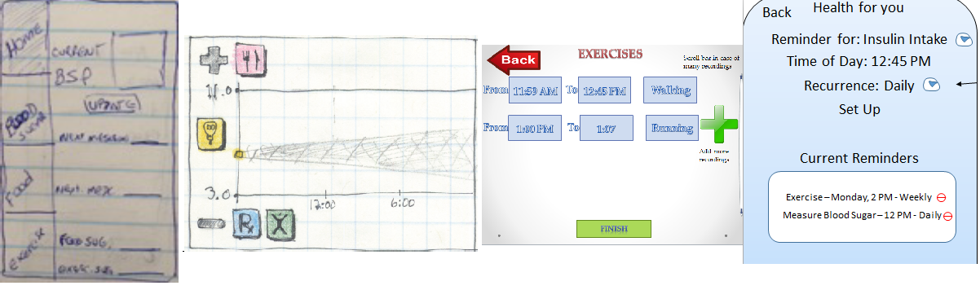
design summary
Five different designs for smartphone apps
4

Slide 11
design evaluations
Group analysis of individual designs
each design was reviewed by all group members
some consensus was reached about the best points of each design, and some common shortcomings
Picking the best ideas
brainstorming session followed to list all of the ideas that were generated
the creative brief was reviewed to reiterate the project objectives
a coherent set of ideas was selected to create the collective design
4

Slide 12
design decisions
Features that help the user learn to manage diabetes, help them interpret data, and make good decisions
preloaded prescription information
preloaded meal and exercise suggestions
database for nutritional values
reminder/alert settings
manual data input
logging of historical data
scatter-plot for blood glucose data
4
Notes:
•to help the user learn how to manage diabetes
•to help them interpret data and make good decisions

Slide 13
design decisions
Interface that makes it easier for the user to understand the interface: no mode changes
drop-down menus instead of scroll bars, for usability
central and persistent menu bar for navigation
pop-ups for settings
consistent page format for different data types
4
Notes:
provide rationales

Slide 14
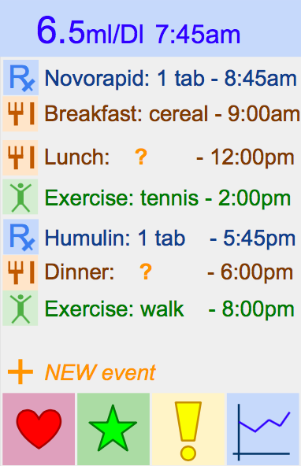
design mock-up
Main screen calendar
orient the user to focus on the events that determine blood glucose
the main menu bar provides a consistent point of reference
4
Notes:
break up, and mention how these meet user needs

Slide 15
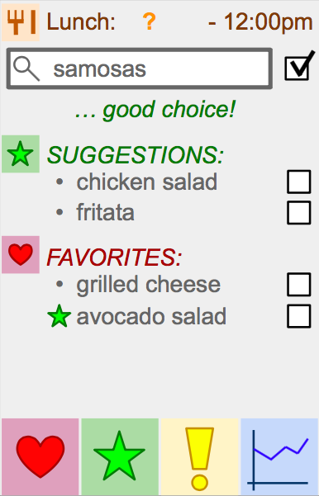
design mock-up
Meal recommendations
provide feedback to the user about their choices
provide suggestions from the healthy options database
encourage forming good habits
4
Notes:
break up, and mention how these meet user needs

Slide 16
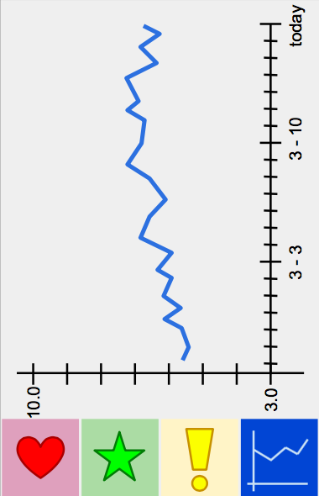
design mock-up
Data history
provide blood glucose data to learn from
4
Notes:
break up, and mention how these meet user needs

Slide 17
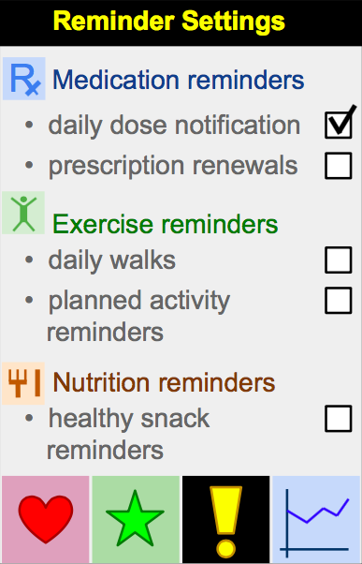
design mock-up
Reminders
remind the user of critical events
help the user establish healthy habits
4
Notes:
break up, and mention how these meet user needs

Slide 18
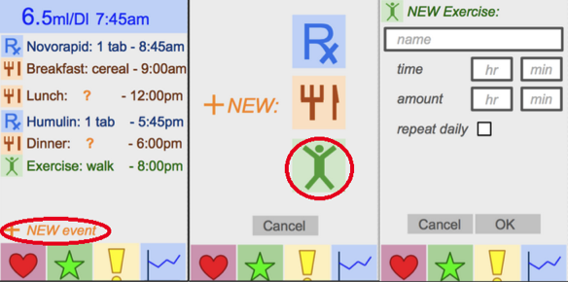
design mock-up
Interaction: adding an activity
4
Notes:
break up, and mention how these meet user needs

Slide 19
Phase 5
5

Slide 20
P4 prototype evaluation
Peer group prototype evaluations
mostly positive feedback
suggestion: main menu buttons need some explanation
suggestion: provide more evident feedback about meal and exercise choices
suggestion: provide prominent visual and auditory aids
suggestion: add an explanation for the graph
5

Slide 21
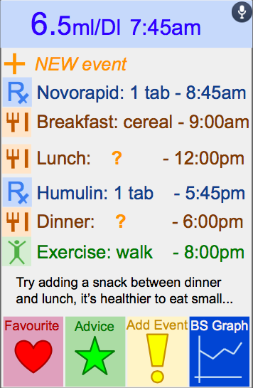
design refinements
Main screen calendar
shift the ‘+ NEW event’ button
add accessibility feature for visually impaired
provide feedback on the day’s plans
clarify the meaning of the main menu icons
5
Notes:
break up, and mention how these meet user needs

Slide 22
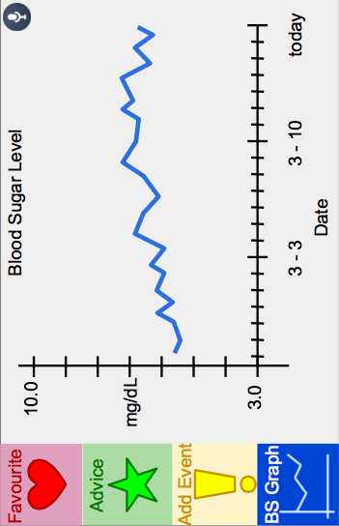
design refinements
Data history
add some explanation
reorient the menu icons
5
Notes:
break up, and mention how these meet user needs

Slide 23
our system’s advantages
our system will
provide centralized access to blood-glucose current data and history
have an expert system for predicting short-term blood-glucose levels and use this for providing advice on healthy choices
provide a database of healthy meal options
present a straightforward interface to the user
anticipate user needs to reduce the need for user input
provide reminders for scheduled insulin doses
5

Slide 24
Thank you! -Group 10

